Slide 1
Dallas Home Sales
Group 8: Richard Liang, Alex Sun, Zhi Gui, Xuelin Lin

Slide 2

Agenda
Overview
Database Design
ERD
Demo

Slide 3
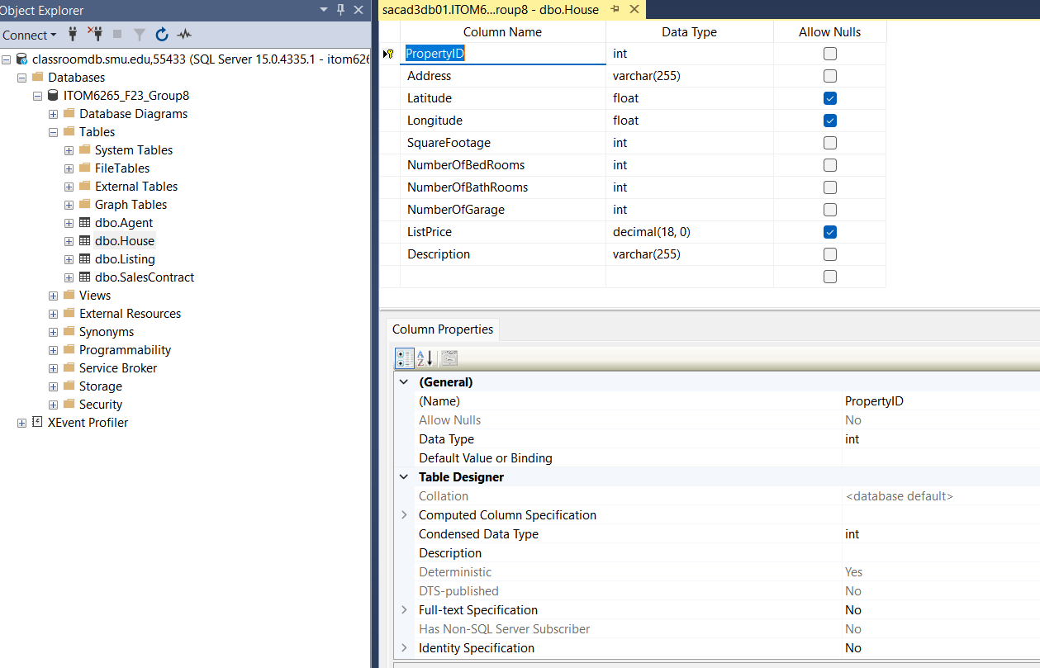
Database Design

Slide 4

Overview
Dallas Home Sales web application is a comprehensive tool designed for the management and analysis of real estate data in Dallas. The app is structured around distinct tabs, each catering to specific functionalities.

Slide 5
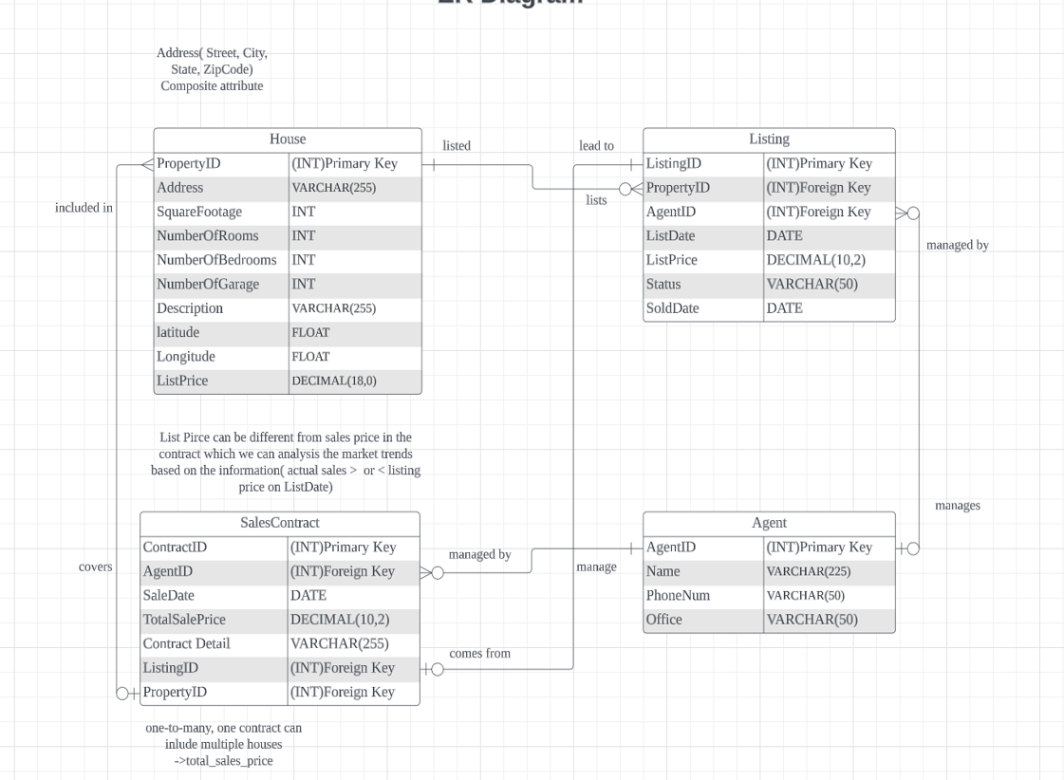
ERD

Slide 6
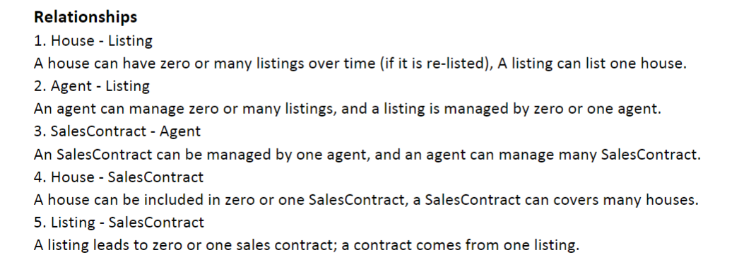
ERD

Slide 7

Shiny
https://kneehowdy.shinyapps.io/ITOM6265_Group8/

Slide 8
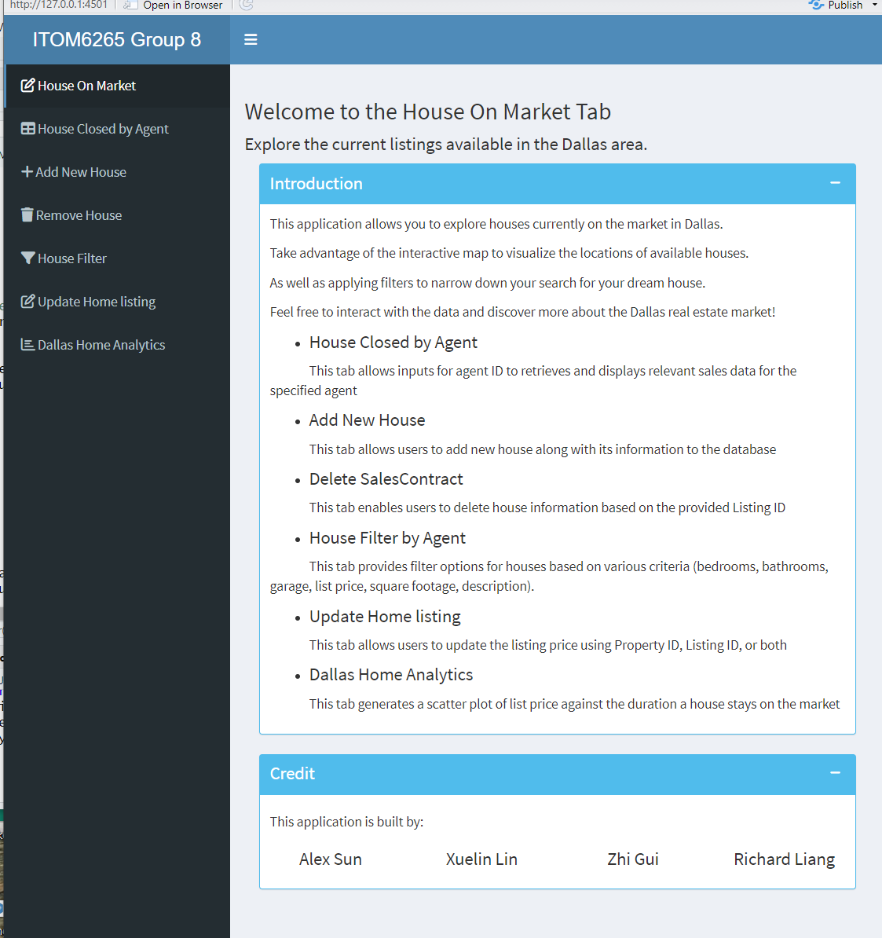
House Closed By Agent

Slide 9
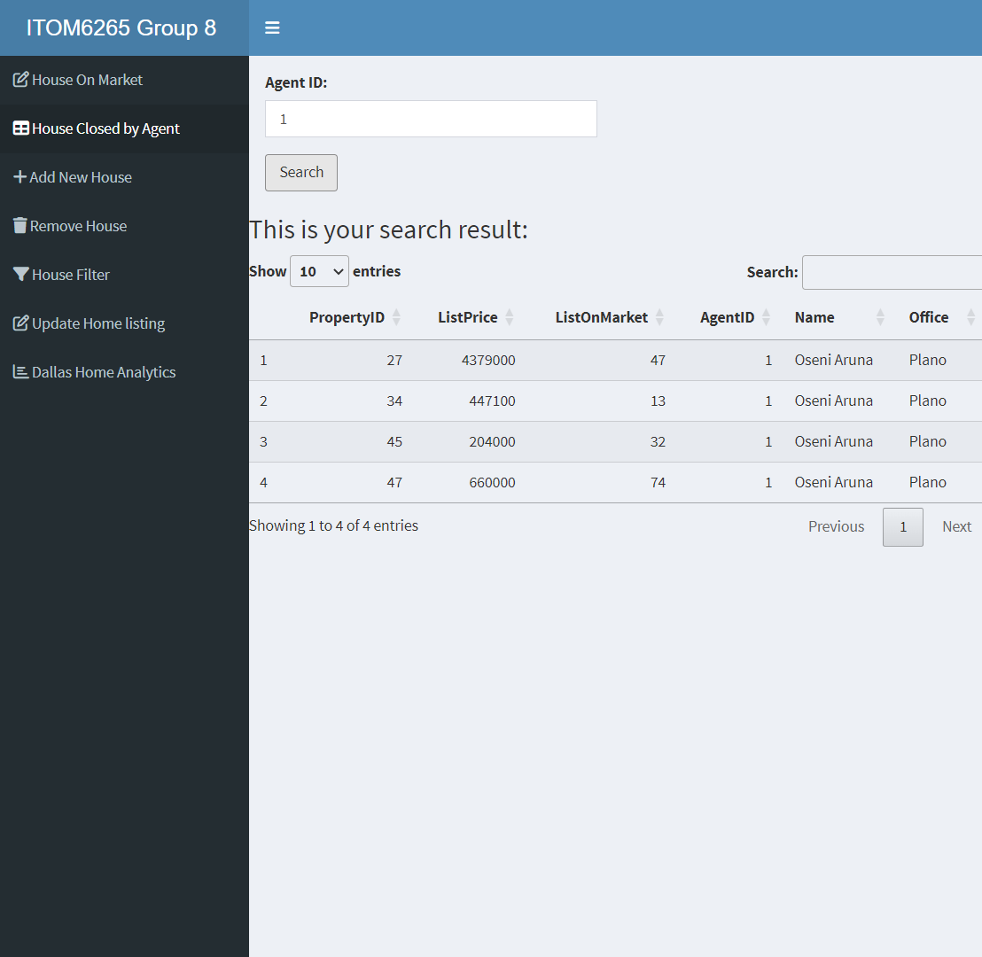
House Closed by Agents

Slide 10
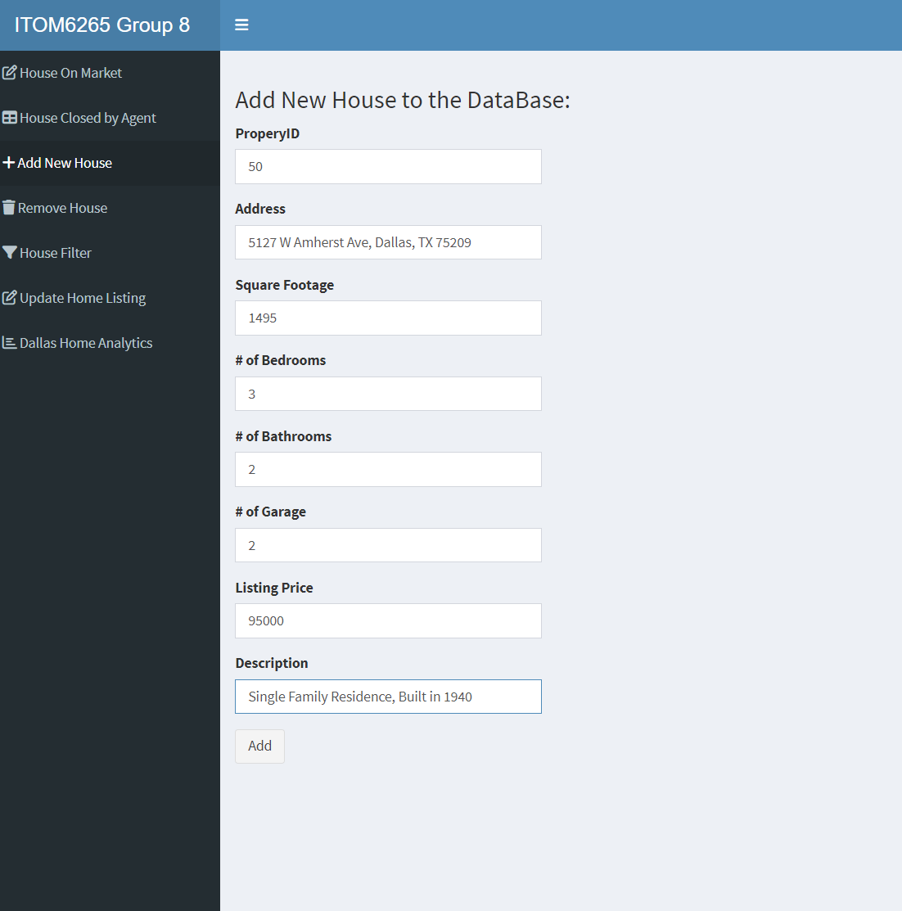
Add New House

Slide 11
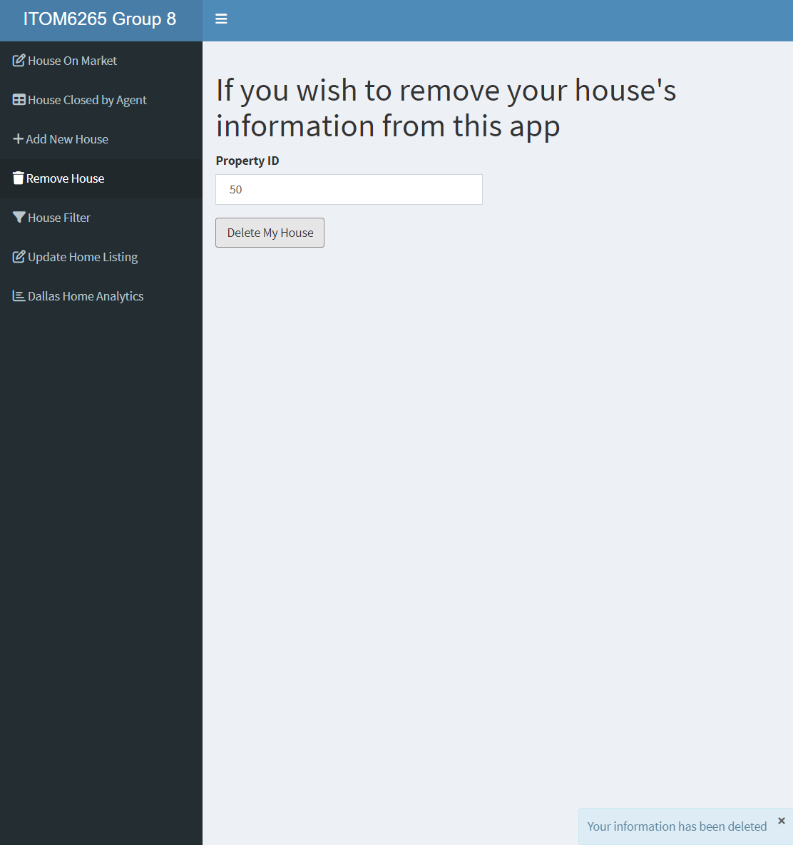
Remove House

Slide 12
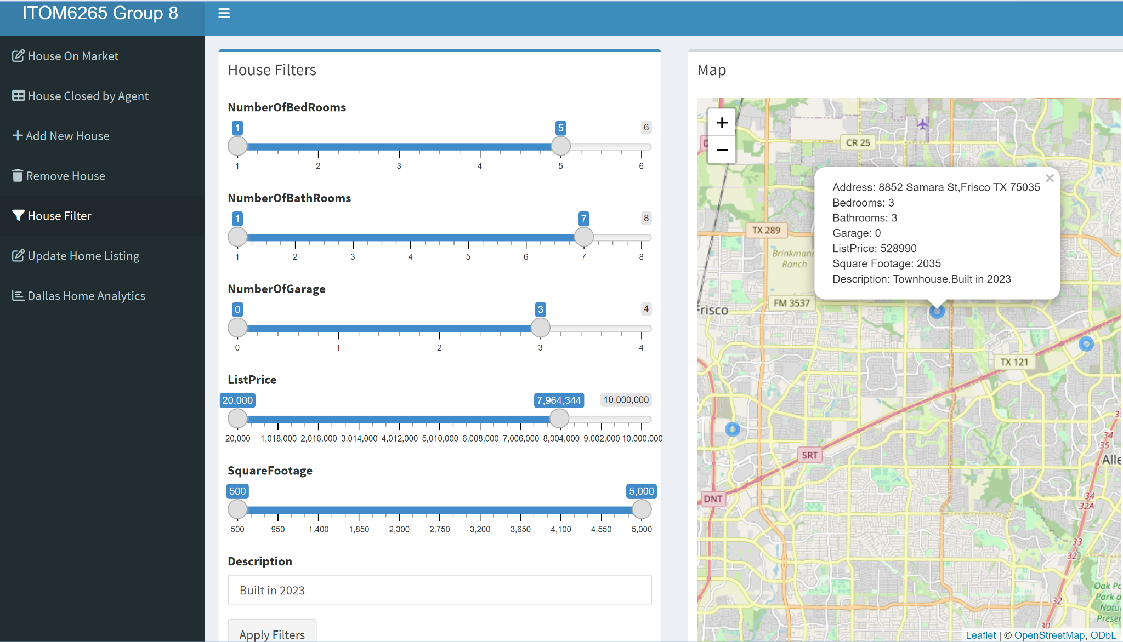
House Filters

Slide 13
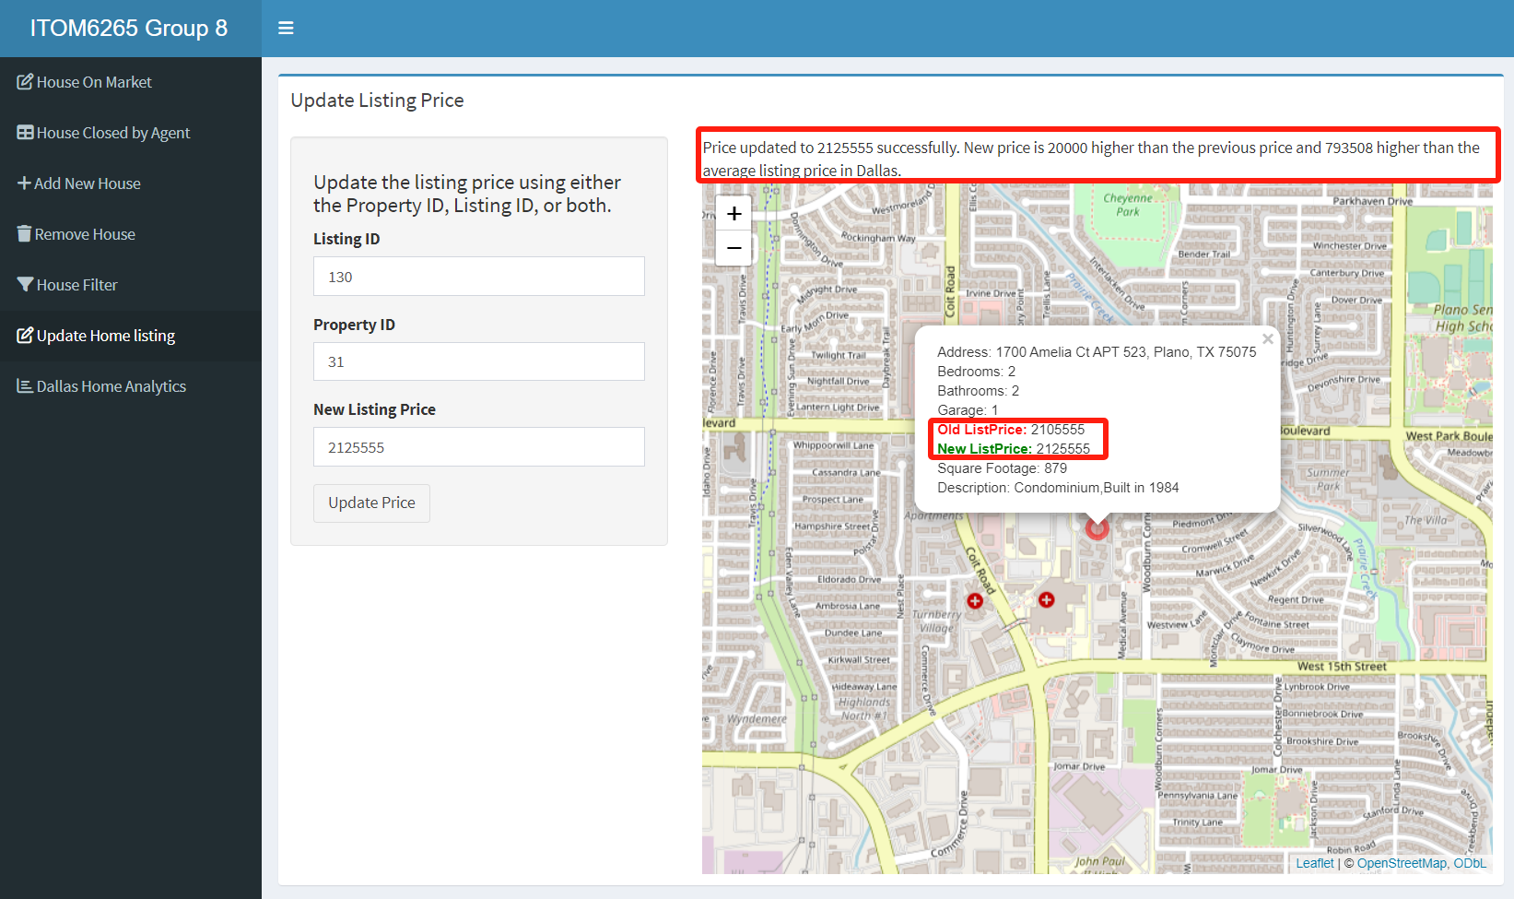
Update Home Listing

Slide 14
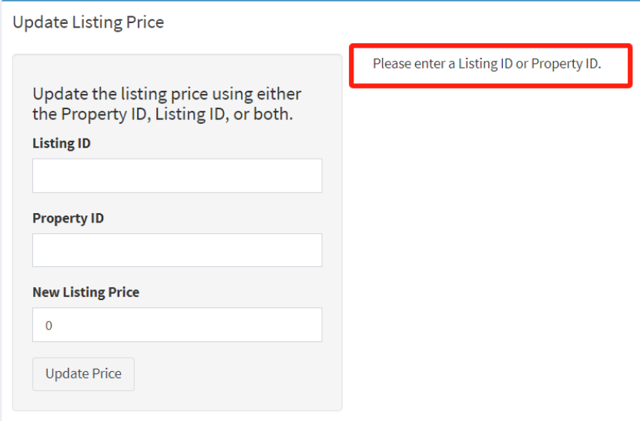
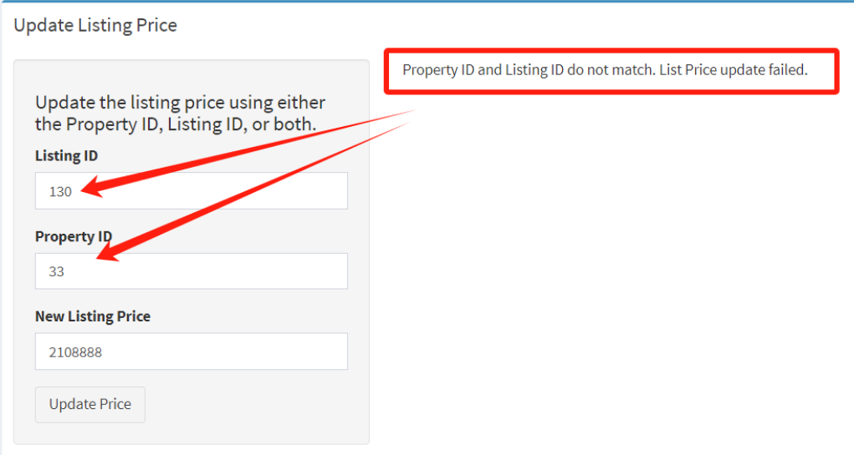
Update Home Listing

Slide 15
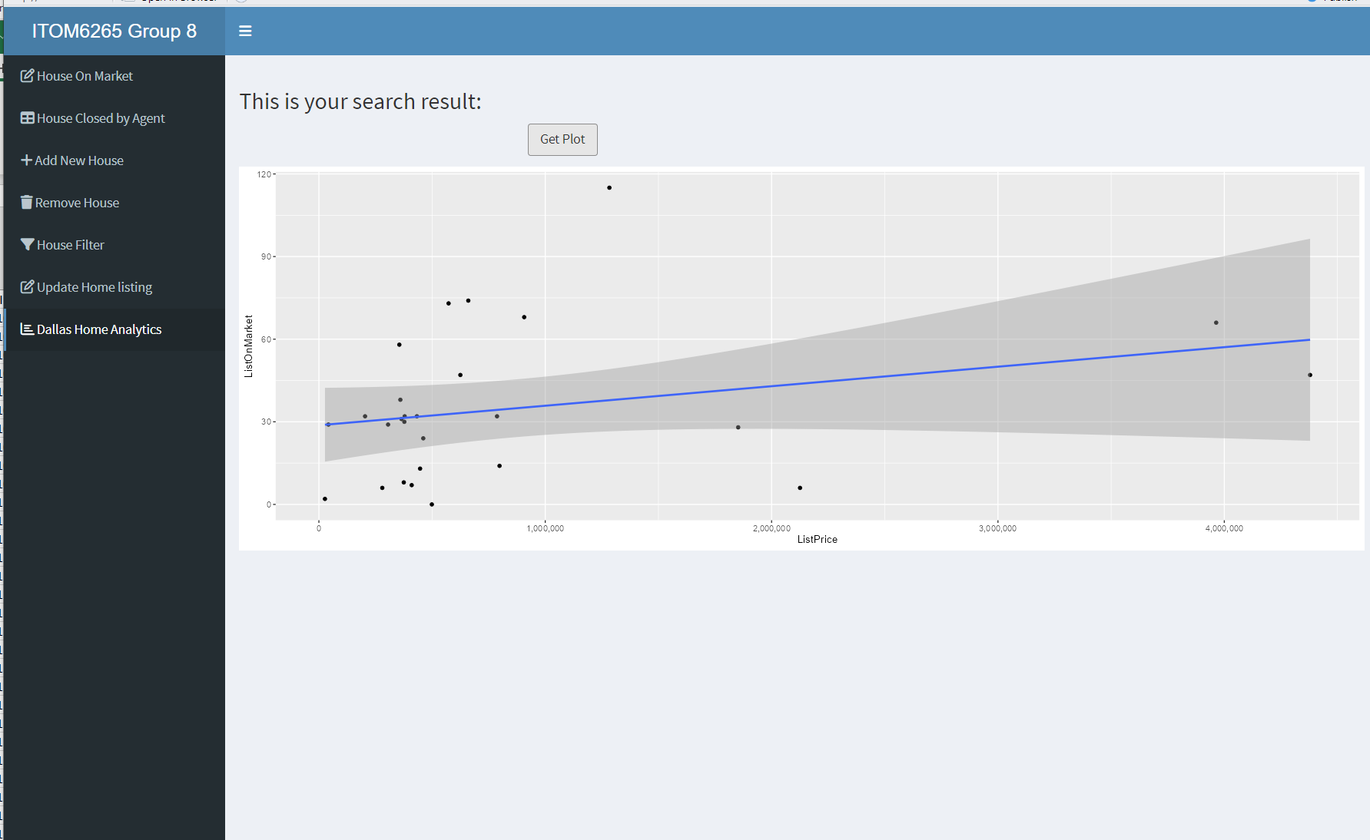
Dallas Home Analytics

Slide 16


